Slide 1


Module 4: Beyond Kubernetes Basics
Kubernetes –
Beyond Basics

Slide 2

Kubernetes Objects

Slide 3
Basic Kubernetes Objects
You use the following objects in Kubernetes:
Pods
Replicasets
Deployments
Services
Namespaces
Labels

Slide 4
About Manifests
In Kubernetes, manifest files declare the desired state of objects.
Manifests have the following properties:
YAML format
Declarative configuration
Desired API primitives
Kubernetes manages the creation of the requested primitives.
Notes:
Manifest files are the new shared language between the developer and the operator. They act as the single source of truth for the configuration of a set of application components (containers). For more information about YAML, see "Yet Another Markup Language" at https://yaml.org/spec/history/2001-05-26.html.

Slide 5
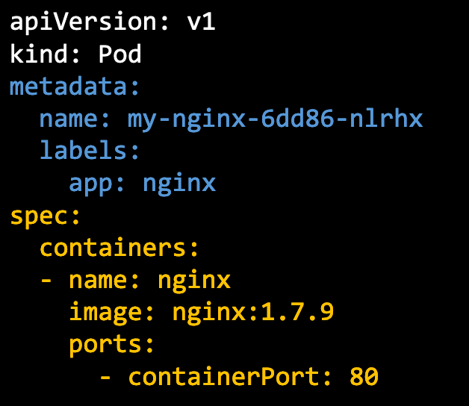
About Pods
A pod is a set of one or more tightly coupled containers.
It is the smallest unit of work in Kubernetes.
Containers in a pod live and die together.
Create a pod example:
The pod has a label app with the value nginx.
The pod runs the image nginx with version 1.7.9.
The pod listens on port 80.
Notes:
For more information about Kubernetes pods, see https://kubernetes.io/docs/concepts/workloads/pods/pod/.
The Kubernetes architecture has many objects and other conceptual primitives.

Slide 6
Multiple Containers in a Pod
A pod typically exists for one container (1:1 relationship)
One or more containers can be included in a pod.
All containers in a pod run on the same node.
Containers in a pod can talk to each other over the localhost.
Containers can share volume resources.
POD
Monitoring Agent Container
Centralized Monitoring
Shared Volume
localhost:3306
write logs
read logs
MySQL
Container
Log Agent Container
Centralized Logging
Pod IP: 192.168.1.10
192.168.1.10:3306
Clients

Slide 7
Sidecar Containers
The term sidecar is commonly used to refer to logging or metric pods that are used to forward
information into another system such as logging or monitoring.
Before
After
Application Container
Application Container
Sidecar
TLS
TLS
Metrics
Metrics
Retries
Retries
Kubernetes Pod
Kubernetes Pod
Notes:
Sidecar containers have the following characteristics:
Do it once and do it right
No duplicated effort
Application-agnostic mechanism

Slide 8
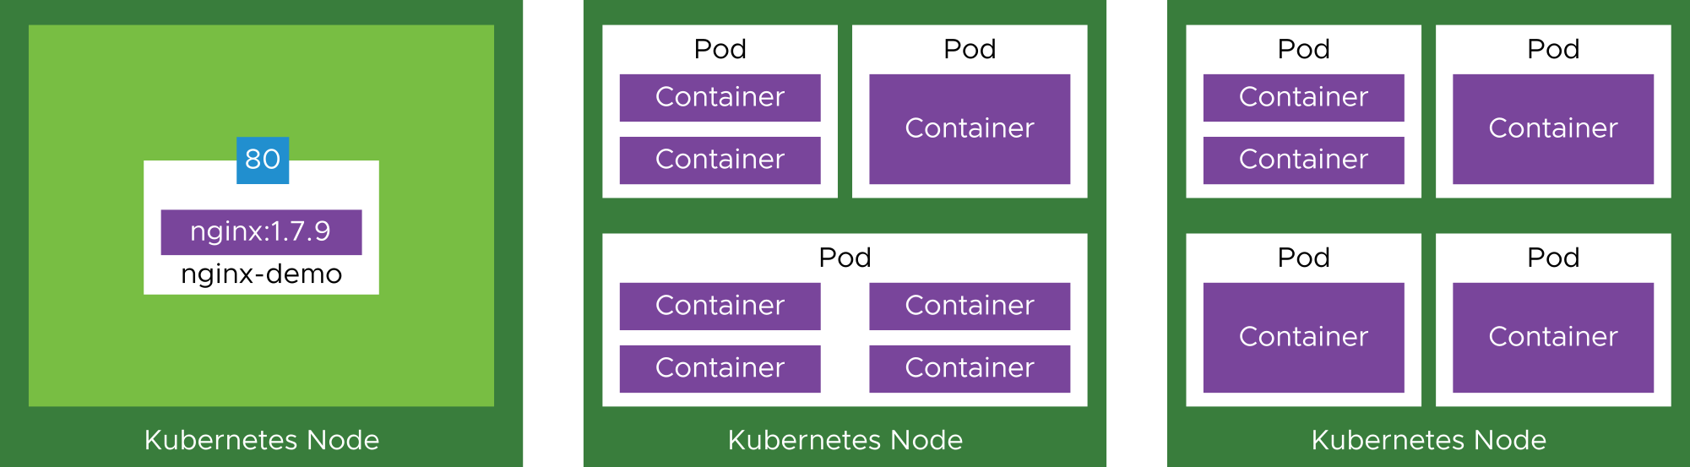
Pod to Worker Node Relationship
Pods run inside Kubernetes worker nodes and can run one or more container processes.

Slide 9
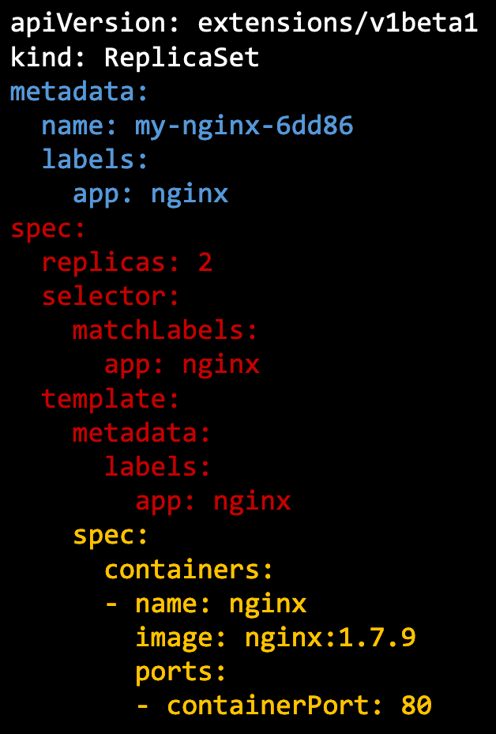
About ReplicaSets (1)
A ReplicaSet declares how the functionality of a pod is made scalable and resilient through redundancy.
With the ReplicaSet, a specified number of pods is kept running.
Create a ReplicaSet example:
The ReplicaSet creates two pods running nginx.
The pods have an app label with the value nginx.
The ReplicaSet ensures that the two pods are always running.

Slide 10
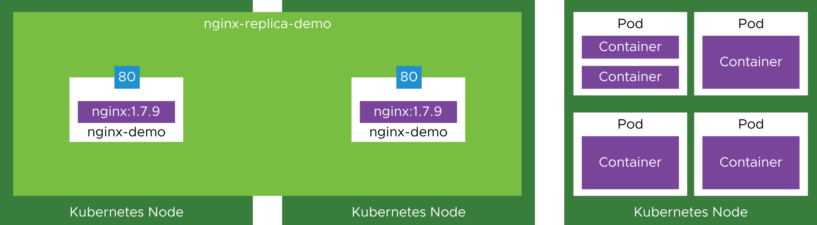
About ReplicaSets (2)
ReplicaSets create and maintain copies of a pod. Replica pods can run on the same Kubernetes node or across nodes.

Slide 11
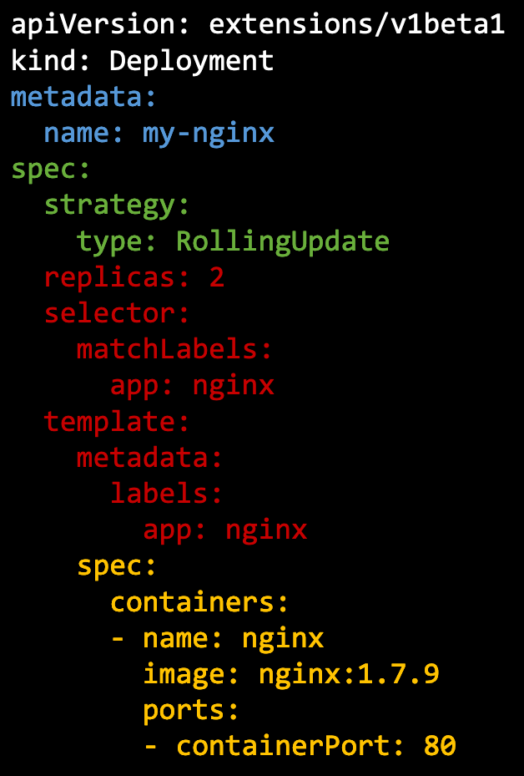
About Deployments (1)
A deployment is the most commonly used object:
Provides rolling updates by creating ReplicaSets and destroying old ReplicaSets automatically
Enables a new version of an image to be deployed without downtime
Create a Deployment example:
The deployment creates a ReplicaSet with two replicas.
The ReplicaSet creates two pods running the nginx image.
When the spec is updated with a new image version, a rolling update is performed all by a single object of the kind Deployment.

Slide 12
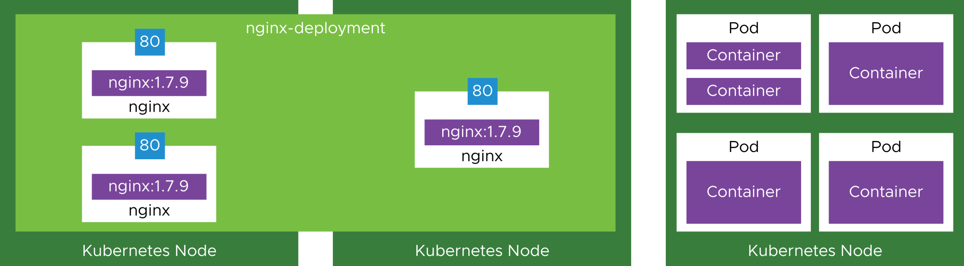
About Deployments (2)
Deployments are commonly used to combine pod and ReplicaSet declarations in a single manifest.

Slide 14
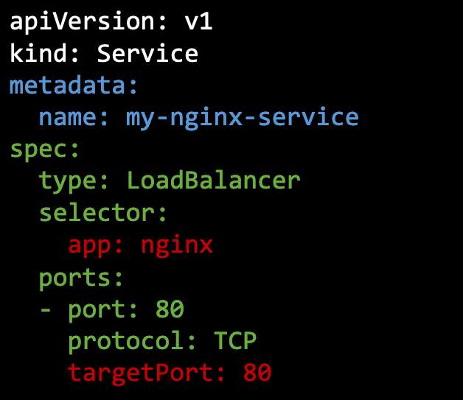
About Services (1)
A service describes how pods discover and communicate with each other and external networks.
A service exposes a deployment as a single IP address.
Create a service example:
The service type is LoadBalancer.
The load balancer listens on port 80.
Traffic is balanced across pods with the app label nginx.
Traffic is sent to pods on target port 80.
Notes:
A service IP address is exposed through one of these ServiceTypes: ClusterIP: Exposes the service on a cluster-internal IP address NodePort: Exposes the service externally as a static port LoadBalancer: Exposes the service externally using a cloud provider’s load balancer ExternalName: Maps the service to a CNAME record

Slide 15
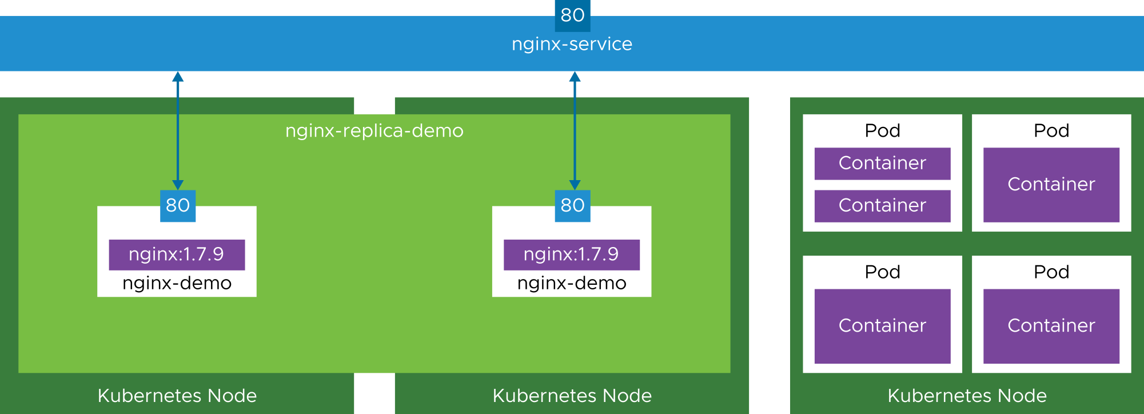
About Services (2)
Services, such as load-balancer services, can expose pods with a static external IP address.

Slide 16
About Labels
A label is a key-value pair attached to pods that conveys user-defined attributes. You aim to standardize key-value pairs across a cluster.
You can use label selectors to select pods with specific labels and apply services or replication controllers to them (they can be functional or organizational).
Labels can be attached to objects during creation and subsequently added and modified at any time.
Labels are indexed, searchable, and best used consistently as a key-value pair across the cluster.
Pod 1
Pod 2
Container
Container
Labels:
tier=frontend, app=myapp
Labels:
tier=backend, app=mysql

Slide 17
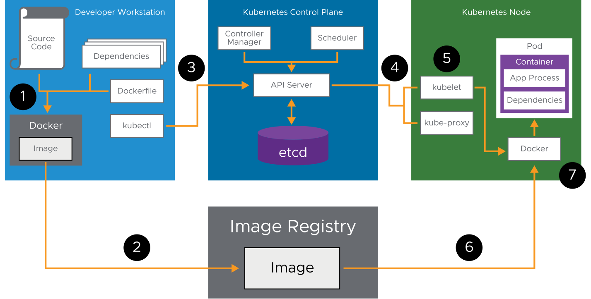
Typical Kubernetes Workflow Example
Example workflow steps:
Build an image from source code and dependencies.
Send the image to the image registry.
Tell Kubernetes to use the image to run a pod.
Scheduler assigns the pod to a node.
Kubelet accepts the pod.
Docker takes the image from the image registry.
Docker starts the container process inside a pod.
Notes:
The example workflow shows how a developer might use Docker to build an image locally, store the image in a registry, and use Kubernetes to manage running the container.
The operational intent is to secure containers, maintain the communication between pods, and ensure that all the code in images runs. The container is managed by the Kubernetes-specific requirements in the manifest for maintaining a robust, resilient, and scalable application by the worker kubelet. The container is also managed by the requirements of the manifest in master etcd. With these details, the developer and operator teams can work together to declare what is needed and, in the process, fulfil customers' needs. Kubernetes supports a fast, dynamic, and continuous process for meeting customer needs.

Slide 18
Typical Kubernetes Workflow: Example Commands
Example commands corresponding to workflow steps:
docker build
docker tag and docker push
kubectl apply –f deployment.yaml
Remaining steps happen as part of Kubernetes orchestration.
Notes:
The example workflow shows how a developer might use Docker to build an image locally, store the image in a registry, and use Kubernetes to manage running the container.
The operational intent is to secure containers, maintain the communication between pods, and ensure that all the code in images runs. The container is managed by the Kubernetes-specific requirements in the manifest for maintaining a robust, resilient, and scalable application by the worker kubelet. The container is also managed by the requirements of the manifest in master etcd. With these details, the developer and operator teams can work together to declare what is needed and, in the process, fulfil customers' needs. Kubernetes supports a fast, dynamic, and continuous process for meeting customer needs.

Slide 19
Deployment Management

Slide 20
Deployments: ReplicaSets
Deployments handle the creation and modification of ReplicaSets.
Pods for a deployment span all valid ReplicaSets.
You do not manually manage ReplicaSets that are owned by a deployment.
NAME DESIRED CURRENT
nginx 3 3
UP-TO-DATE AVAILABLE AGE CONTAINER(S) IMAGE(S)
3 3 23m nginx nginx:1.13.1

Slide 21
Built-In Deployment Strategies
RollingUpdate deployment:
This type is the default if a deployment is not defined.
A new ReplicaSet is created and then scaled up as the old ReplicaSet is scaled down.
Recreate deployment:
Removes all existing pods in the existing ReplicaSet first
Creates new pods in the new ReplicaSet

Slide 22
Deployment Strategies: RollingUpdate (1)
Applications are constantly being improved and updated. An easy and efficient way to deploy a new version is available through the Deployment object.
Deployment: nginx
ReplicaSet - image: nginx:1.13.1
Pod 1
Pod 2
Pod 3

Slide 23
Deployment Strategies: RollingUpdate (2)
Deployment: nginx
ReplicaSet - image: nginx:1.13.1
Pod 1
Pod 2
Pod 3
ReplicaSet - image: nginx:1.13.2

Slide 24
Deployment Strategies: RollingUpdate (3)
Deployment: nginx
ReplicaSet - image: nginx:1.13.1
Pod 1
Pod 2
Pod 3
ReplicaSet - image: nginx:1.13.2
Pod 1

Slide 25
Deployment Strategies: RollingUpdate (4)
Deployment: nginx
ReplicaSet - image: nginx:1.13.1
Pod 1
Pod 2
ReplicaSet - image: nginx:1.13.2
Pod 1

Slide 26
Deployment Strategies: RollingUpdate (5)
Deployment: nginx
ReplicaSet - image: nginx:1.13.1
Pod 1
Pod 2
ReplicaSet - image: nginx:1.13.2
Pod 1
Pod 2

Slide 27
Deployment Strategies: RollingUpdate (6)
Deployment: nginx
ReplicaSet - image: nginx:1.13.1
Pod 1
ReplicaSet - image: nginx:1.13.2
Pod 1
Pod 2

Slide 28
Deployment Strategies: RollingUpdate (7)
Deployment: nginx
ReplicaSet - image: nginx:1.13.1
Pod 1
ReplicaSet - image: nginx:1.13.2
Pod 1
Pod 2
Pod 3

Slide 29
Deployment Strategies: RollingUpdate (8)
Deployment: nginx
ReplicaSet - image: nginx:1.13.1
ReplicaSet - image: nginx:1.13.2
Pod 1
Pod 2
Pod 3

Slide 30
Deployment Strategies: Recreate (1)
Using the recreate update causes the container to become unavailable for a short duration.
Deployment: nginx
ReplicaSet - image: nginx:1.13.1
Pod 1
Pod 2
Pod 3

Slide 31
Deployment Strategies: Recreate (2)
Deployment: nginx
ReplicaSet - image: nginx:1.13.1
Pod 1
Pod 2

Slide 32
Deployment Strategies: Recreate (3)
Deployment: nginx
ReplicaSet - image: nginx:1.13.1
Pod 1

Slide 33
Deployment Strategies: Recreate (4)
Deployment: nginx
ReplicaSet - image: nginx:1.13.1

Slide 34
Deployment Strategies: Recreate (5)
Deployment: nginx
ReplicaSet - image: nginx:1.13.1
ReplicaSet - image: nginx:1.13.2
Pod 1

Slide 35
Deployment Strategies: Recreate (6)
Deployment: nginx
ReplicaSet - image: nginx:1.13.1
ReplicaSet - image: nginx:1.13.2
Pod 1
Pod 2

Slide 36
Deployment Strategies: Recreate (7)
Deployment: nginx
ReplicaSet - image: nginx:1.13.1
ReplicaSet - image: nginx:1.13.2
Pod 1
Pod 2
Pod 3

Slide 37
Deployment Strategies: Canary and Blue/Green
Canary deployment:
Deploy new container to a subset of traffic
Involves two deployments and label management between them
Blue/Green deployment:
Deploy all new containers, test, and flip or switch traffic to new containers
Involves two deployments and label management between them

Slide 38
Deployment Strategies: Canary (1)
Deployment: nginx-stable
labels: app: blog
tier: frontend track: stable
spec:
replicas: 3
spec:
containers:
- name: nginx
image: nginx:1.13.1
Pod 1
Pod 2
Pod 3
selector: app: blog
tier: frontend

Slide 39
Deployment Strategies: Canary (2)
Deployment: nginx-stable
labels: app: blog
tier: frontend track: stable
spec:
replicas: 3
spec:
containers:
- name: nginx
image: nginx:1.13.1
Pod 1
Pod 2
Pod 3
selector: app: blog
tier: frontend
Deployment: nginx-canary
labels: app: blog
tier: frontend track: canary
spec:
replicas: 1
spec:
containers:
- name: nginx
image: nginx:1.13.2
Pod 1

Slide 40
Deployment Strategies: Canary (3)
Deployment: nginx-stable
labels: app: blog
tier: frontend track: stable
spec:
replicas: 3
spec:
containers:
- name: nginx
image: nginx:1.13.2
Update to the latest version and apply.
Pod 1
Pod 2
Pod 3
selector: app: blog
tier: frontend
Deployment: nginx-canary
labels: app: blog
tier: frontend track: canary
spec:
replicas: 0
spec:
containers:
- name: nginx
image: nginx:1.13.2
Remove canary.

Slide 41
Deployment Strategies: Blue/Green (1)
Deployment: nginx-blue
labels: app: blog
tier: frontend color: blue
spec:
replicas: 3
spec:
containers:
- name: nginx
image: nginx:1.13.1
Pod 1
Pod 2
Pod 3
selector: app: blog
tier: frontend
color: blue

Slide 42
Deployment Strategies: Blue/Green (2)
Deployment: nginx-blue
labels: app: blog
tier: frontend color: blue
spec:
replicas: 3 spec:
containers:
- name: nginx
image: nginx:1.13.1
Pod 1
Pod 2
Pod 3
selector: app: blog
tier: frontend
color: blue
Deployment: nginx-green
labels: app: blog
tier: frontend color: green
spec:
replicas: 3 spec:
containers:
- name: nginx
image: nginx:1.13.2
Pod 1
Pod 2
Pod 3

Slide 43
Deployment Strategies: Blue/Green (3)
Deployment: nginx-blue
labels: app: blog
tier: frontend color: blue
spec:
replicas: 3 spec:
containers:
- name: nginx
image: nginx:1.13.1
Pod 1
Pod 2
Pod 3
selector: app: blog
tier: frontend
color: green
Deployment: nginx-green
labels: app: blog
tier: frontend color: green
spec:
replicas: 3 spec:
containers:
- name: nginx
image: nginx:1.13.2
Pod 1
Pod 2
Pod 3
Flip the switch.

Slide 44
Deployment Strategies: Blue/Green (4)
Deployment: nginx-blue
labels: app: blog
tier: frontend color: blue
spec:
replicas: 0 spec:
containers:
- name: nginx
image: nginx:1.13.1
Clean up.
selector: app: blog
tier: frontend
color: green
Deployment: nginx-green
labels: app: blog
tier: frontend color: green
spec:
replicas: 3 spec:
containers:
- name: nginx
image: nginx:1.13.2
Pod 1
Pod 2
Pod 3

Slide 45
Pod and Container Configurations

Slide 46
Resource Requests
A resource request can be thought of as minimum resource required specification:
Resource requests help Kubernetes schedule pods efficiently.
Pods are scheduled if the sum of the resource requests of the scheduled containers is less than the capacity of the node.
containers:
- name: db image: mysql resources:
requests:
memory: "512Mi" cpu: "0.5"

Slide 47
Resource Limits
Resource limits protect against a runaway application.
If a container exceeds its memory limit, it might be terminated.
If a container exceeds its memory request, it is likely that its pod will be evicted whenever the node runs out of memory.
containers:
- name: db image: mysql resources:
limits:
memory: "1Gi" cpu: "1"

Slide 48
Resource Management: Defining CPU Values
CPU units:
1 AWS vCPU
1 GCP Core
1 Azure vCore
1 hyperthread on a bare-metal Intel processor with hyperthreading
CPU values:
0.1 = 100 m
One hundred millicpu / 10% of a CPU unit

Slide 49
Resources: Defining Memory Values
Memory units:
T, G, M, K: 10 based
Ti, Gi, Mi, Ki: Power of 2 based
Memory values:
512M != 512 Mi
Easier to just specify the true/proper i suffix style

Slide 50
Container Networking

Slide 51



CNI Providers
Common Kubernetes Container Network Interface (CNI) implementations that affect networking include:
Kubenet
Flannel/Calico
Weave Net
Common VMware Tanzu choices:
Contour
NSX-T Data Center
NSX Advanced Load Balancer (Avi)
Antrea
Project Calico
HAProxy
https://foo.bar.com/foo
https://foo.bar.com/bar
Kubernetes Cluster
Ingress Pod
Foo Service
Bar Service
Pod
Pod
Pod
Pod
Pod
Pod
Notes:
For a complete list of Container Network Interface (CNI) providers, see the landscape chart at http://l.cncn.io.

Slide 52
Networking: Within a Pod
The containers within a pod have the following capabilities:
Can connect to each other using localhost
Share an IP address accessible throughout the cluster
Share a common port space (but beware of conflicts)
These capabilities closely mimic those of multiple processes running on the same virtual machine.

Slide 53
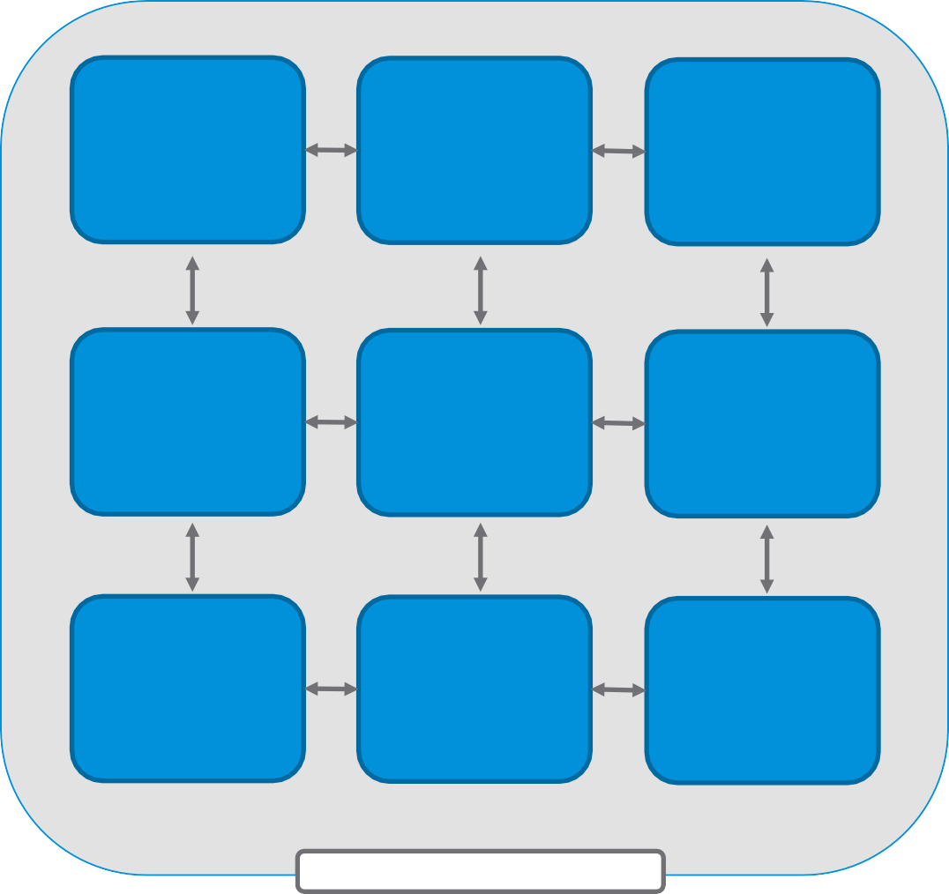
Networking: Pod to Pod
Every pod is assigned an IP address.
This IP address is routable anywhere within the cluster.
The implementation of connectivity between all pods in the cluster is the responsibility of the CNI that was implemented.
Pod | Pod | Pod
192.168.1.10 | 192.168.1.11 | 192.168.1.12
Pod | Pod | Pod
192.168.2.10 | 192.168.2.11 | 192.168.2.12
Pod
192.168.3.10
Pod
192.168.3.10
Pod
192.168.3.11
Pod
192.168.3.12
Kubernetes Cluster

Slide 54
Networking: Services to Pods
A service is a Kubernetes resource:
Layer 4 load balancing for a group of pods
Service discovery using the cluster’s internal DNS
Several types of services are available:
ClusterIP
NodePort
LoadBalancer

Slide 55
Kubernetes Services
Services provide reliable networking.
Pods are ephemeral by design:
Pods fail and can be replaced.
New pods get a new IP address.
Scale up: New pods can be introduced.
Scale down: Pods can be removed.
A service is an object in the Kubernetes API
Worker Node
Node IP:
192.168.10.10
Service
DNS: service1.cluster.local
Port: 9443
NodePort: 31233
Protocol: TCP
Pod 1
Pod 2
Pod N
Port: 9443
Notes:
Pods are ephemeral and their IP address might change if they are restarted. You can reliably reference your back-end container from a front-end container:
Pods are ephemeral and are removed or rescheduled continuously.
An abstraction layer is present above sets of objects so that you do not need to trace specific objects as they restart.
Provides a single endpoint for the underlying set of objects (pod replicas).
A logical, internal load balancer for a set of related pods (an application).
A single IP address and DNS name to refer to the set of pods.

Slide 56
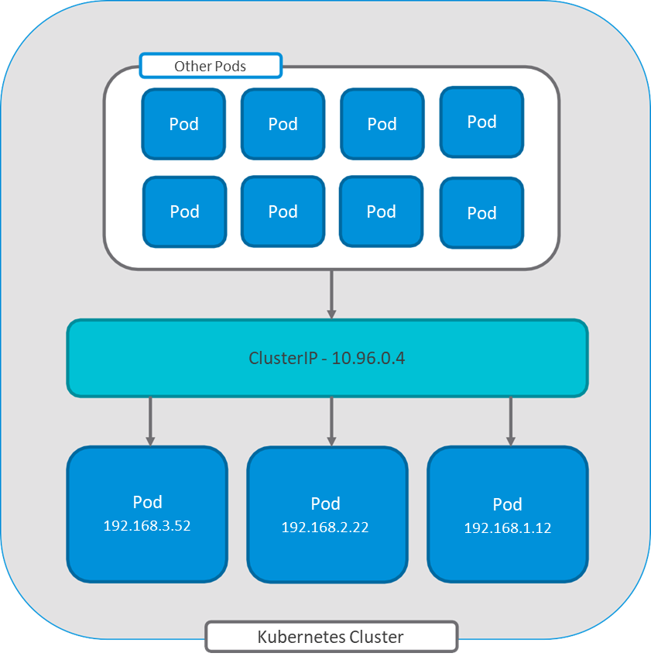
Service Type: ClusterIP
The ClusterIP service type is used for internal-facing services.
Implementation:
A virtual IP address load balances requests to a set of back-end pods.
Accessible anywhere within the cluster.
Not externally accessible.

Slide 57
Service Type: NodePort
The NodePort service type is used for external-facing services.
Implementation:
Exposes a port on each worker node
Externally accessible
Uses ClusterIP for load balancing to pods
NodePort - :31204
ClusterIP - 10.96.0.4
Pod
192.168.1.10
Pod
192.168.1.11
Pod
192.168.1.12
Kubernetes Cluster

Slide 58
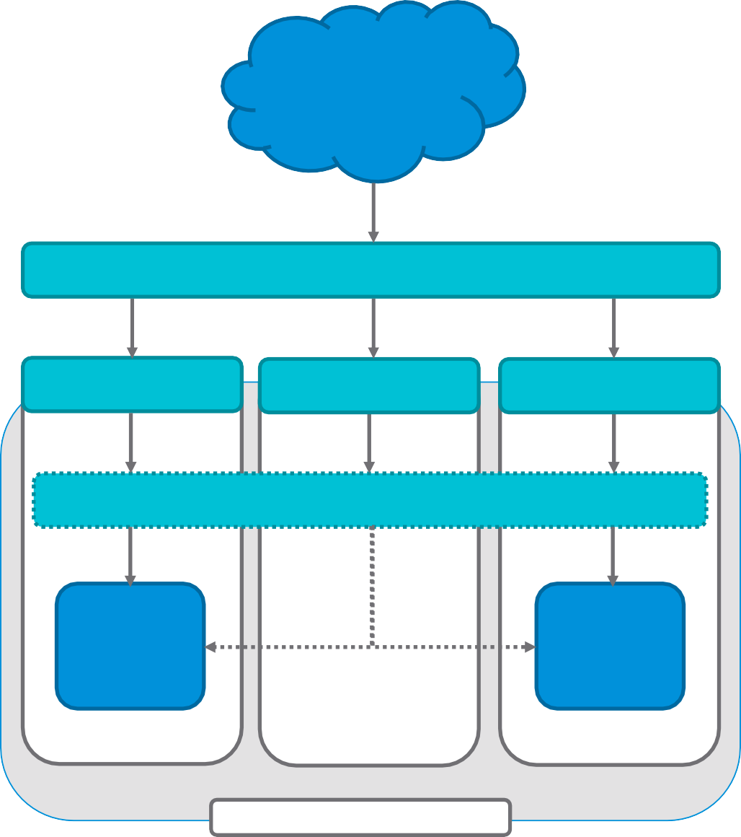
Service Type: LoadBalancer
The LoadBalancer service type creates and manages an external load balancer.
Implementation varies based on the selected CNI or LoadBalancer:
You can use NodePort for traffic ingress, which uses ClusterIP for load balancing to pods.
Plug-ins are available for different implementations.
The NSX-T Data Center load balancer connects directly to the pod.
NodePort | External Load Balancer NodePort | NodePort
:31204 | :31204 | :31204
 | ClusterIP - 10.96.0.4
Pod 192.168.1.10 |  | Pod 192.168.1.11
Worker 1 | Worker 2 | Worker 3
Kubernetes Cluster

Slide 59
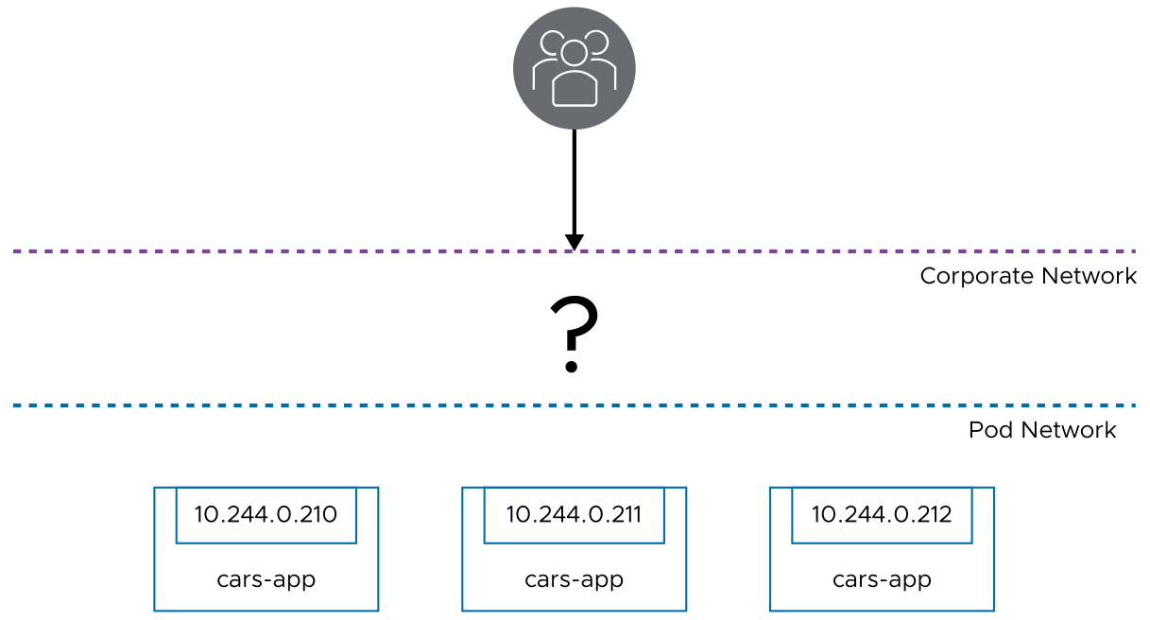
Kubernetes Services (1)
Typically, pods run on a network that is not routable. To provide external access into pods, you use services.
Notes:
Services can provide a static IP address. As pods scale in and out, their IP addresses change. With services, you can access pods from a known address without worrying about the IP address of the pods.

Slide 60
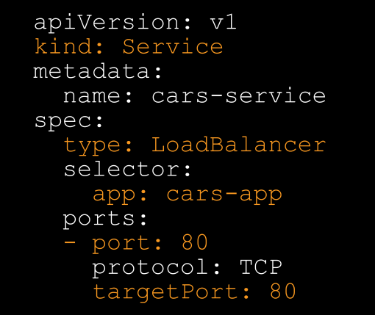
Kubernetes Services (2)
A service describes how pods discover and communicate with each other and external networks.
A service exposes pods as a single IP address.
Deploy a Service example:
Service name is cars-service.
It is a LoadBalancer service.
It should listen on port 80.
Notes:
A service IP address is exposed through one of these ServiceTypes:
ClusterIP: Exposes the service on a cluster-internal IP address
NodePort: Exposes the service externally as a static port
LoadBalancer: Exposes the service externally
ExternalName: Maps the service to a CNAME record
For more information about Kubernetes services, see https://kubernetes.io/docs/concepts/services-networking/service/.

Slide 61
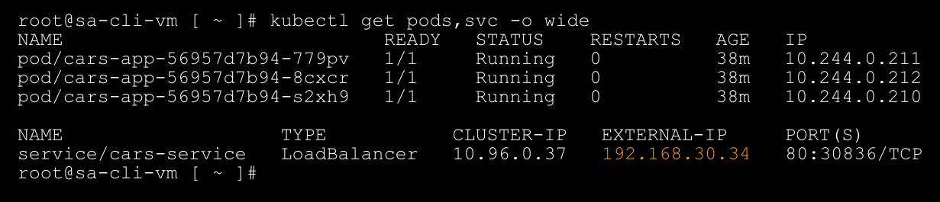
Kubernetes Services (3)
A developer can create a Kubernetes service of the type LoadBalancer.
The implementation of LoadBalancer depends on the chosen CNI provider.
Notes:
The NSX server load balancer is created during vSphere with Tanzu cluster enablement. It is sized as a medium load balancer.

Slide 62
Kubernetes Services (4)
A LoadBalancer service creates an externally accessible IP address and depends on the chosen CNI.
Corporate Network
192.168.30.34
cars-service
Pod Network
10.244.0.210
10.244.0.211
10.244.0.212
cars-app
cars-app
cars-app
Notes:
The image on the slide shows how NSX-T Data Center load balancer works.

